Slide 1
Team 14
Justin-Marian Popescu
Alfred-Andrei Pietraru
🪳
🪳Bug fixes
🪳
🪳
Training phases
Burn-in: component losses (cls / box / obj) did not converge synchronously → required separate monitoring
EMA-SSL: EMA accumulation hidden temporary degradation of the student → direct student vs EMA evaluation
EMA-SSL: teacher-student agreement unstable under class-imbalanced distributions
🪳
Validation phases
Burn-in: validation metrics increased slower than training loss → early overconfidence indicator
Burn-in: high confusion between visually similar classes, stabilized only after detection head convergence
EMA-SSL: train–validation gap reduced via filtered pseudo-labeling (threshold + NMS + agg class boxes)
EMA-SSL: clear recall improvements, with increased risk of false positives
EMA-SSL: EMA validation is more stable than raw student evaluation
🪳
🪳
🪳
🪳
1/5

Slide 2
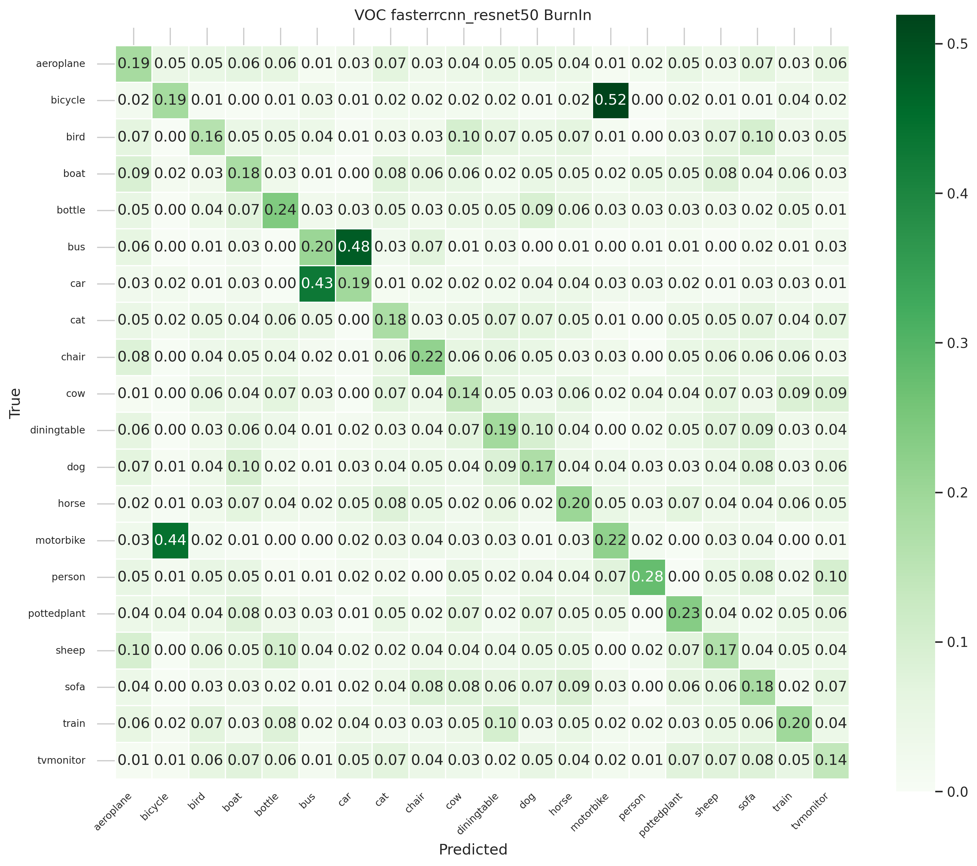
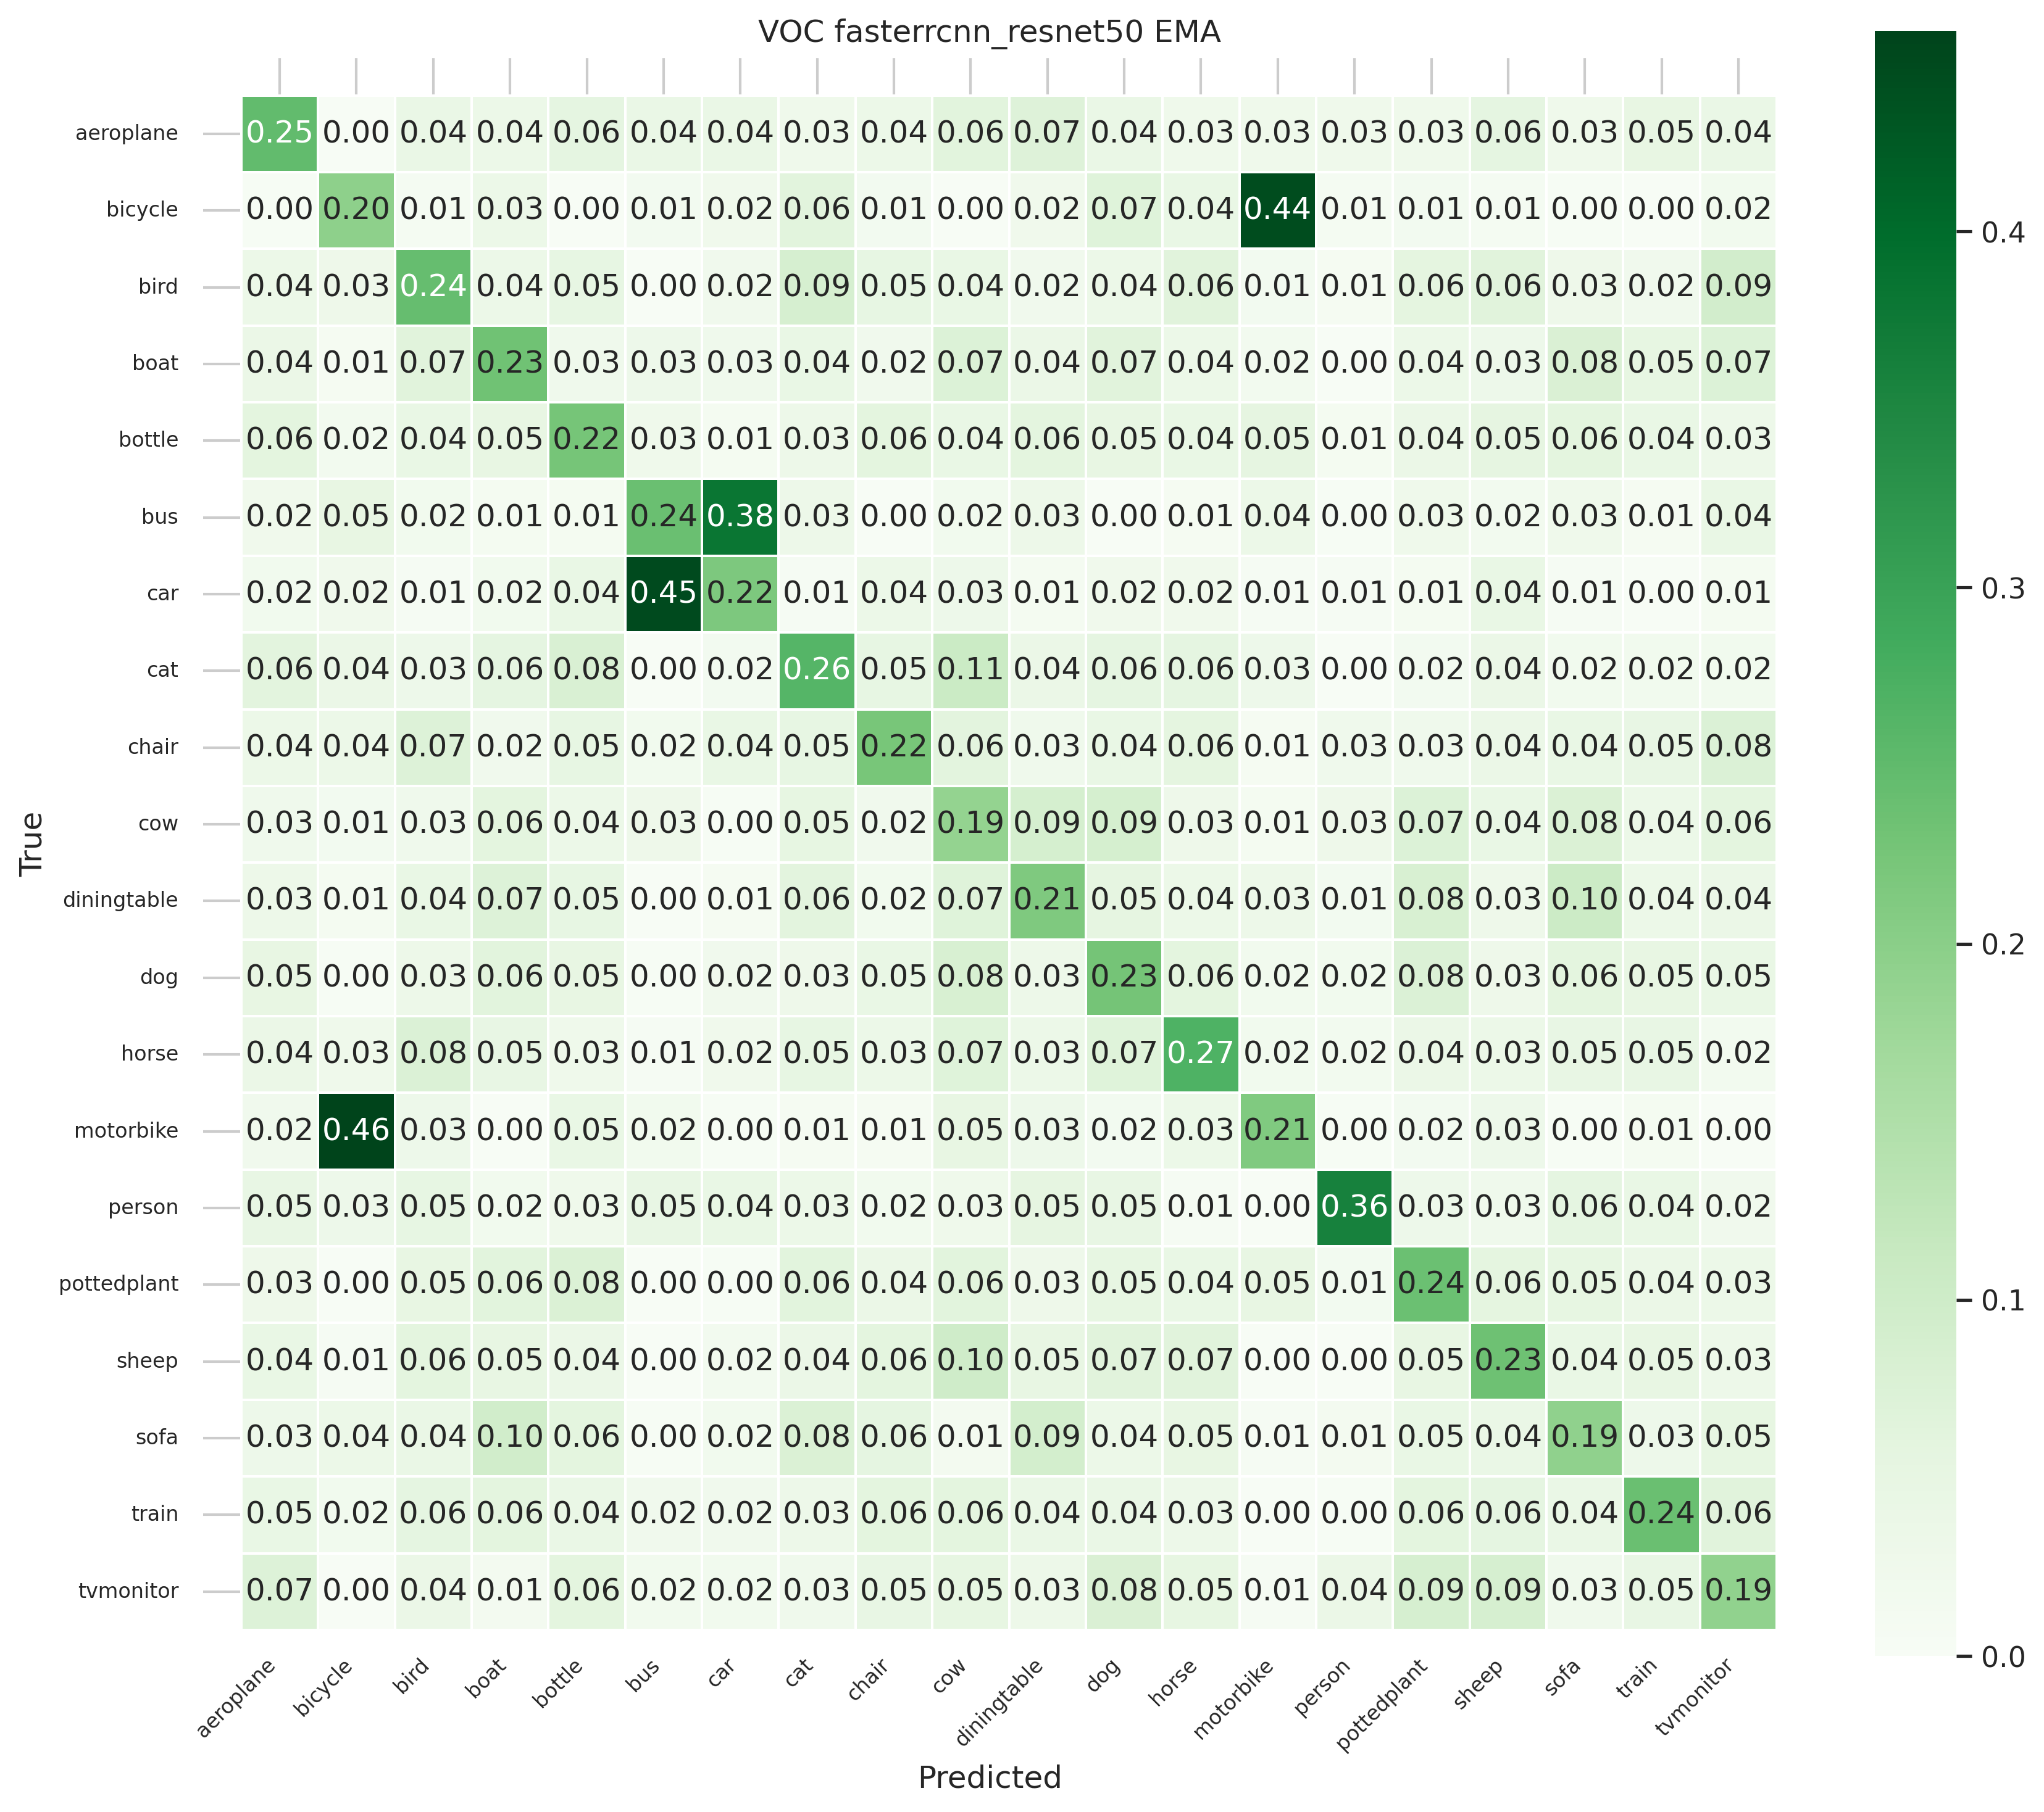
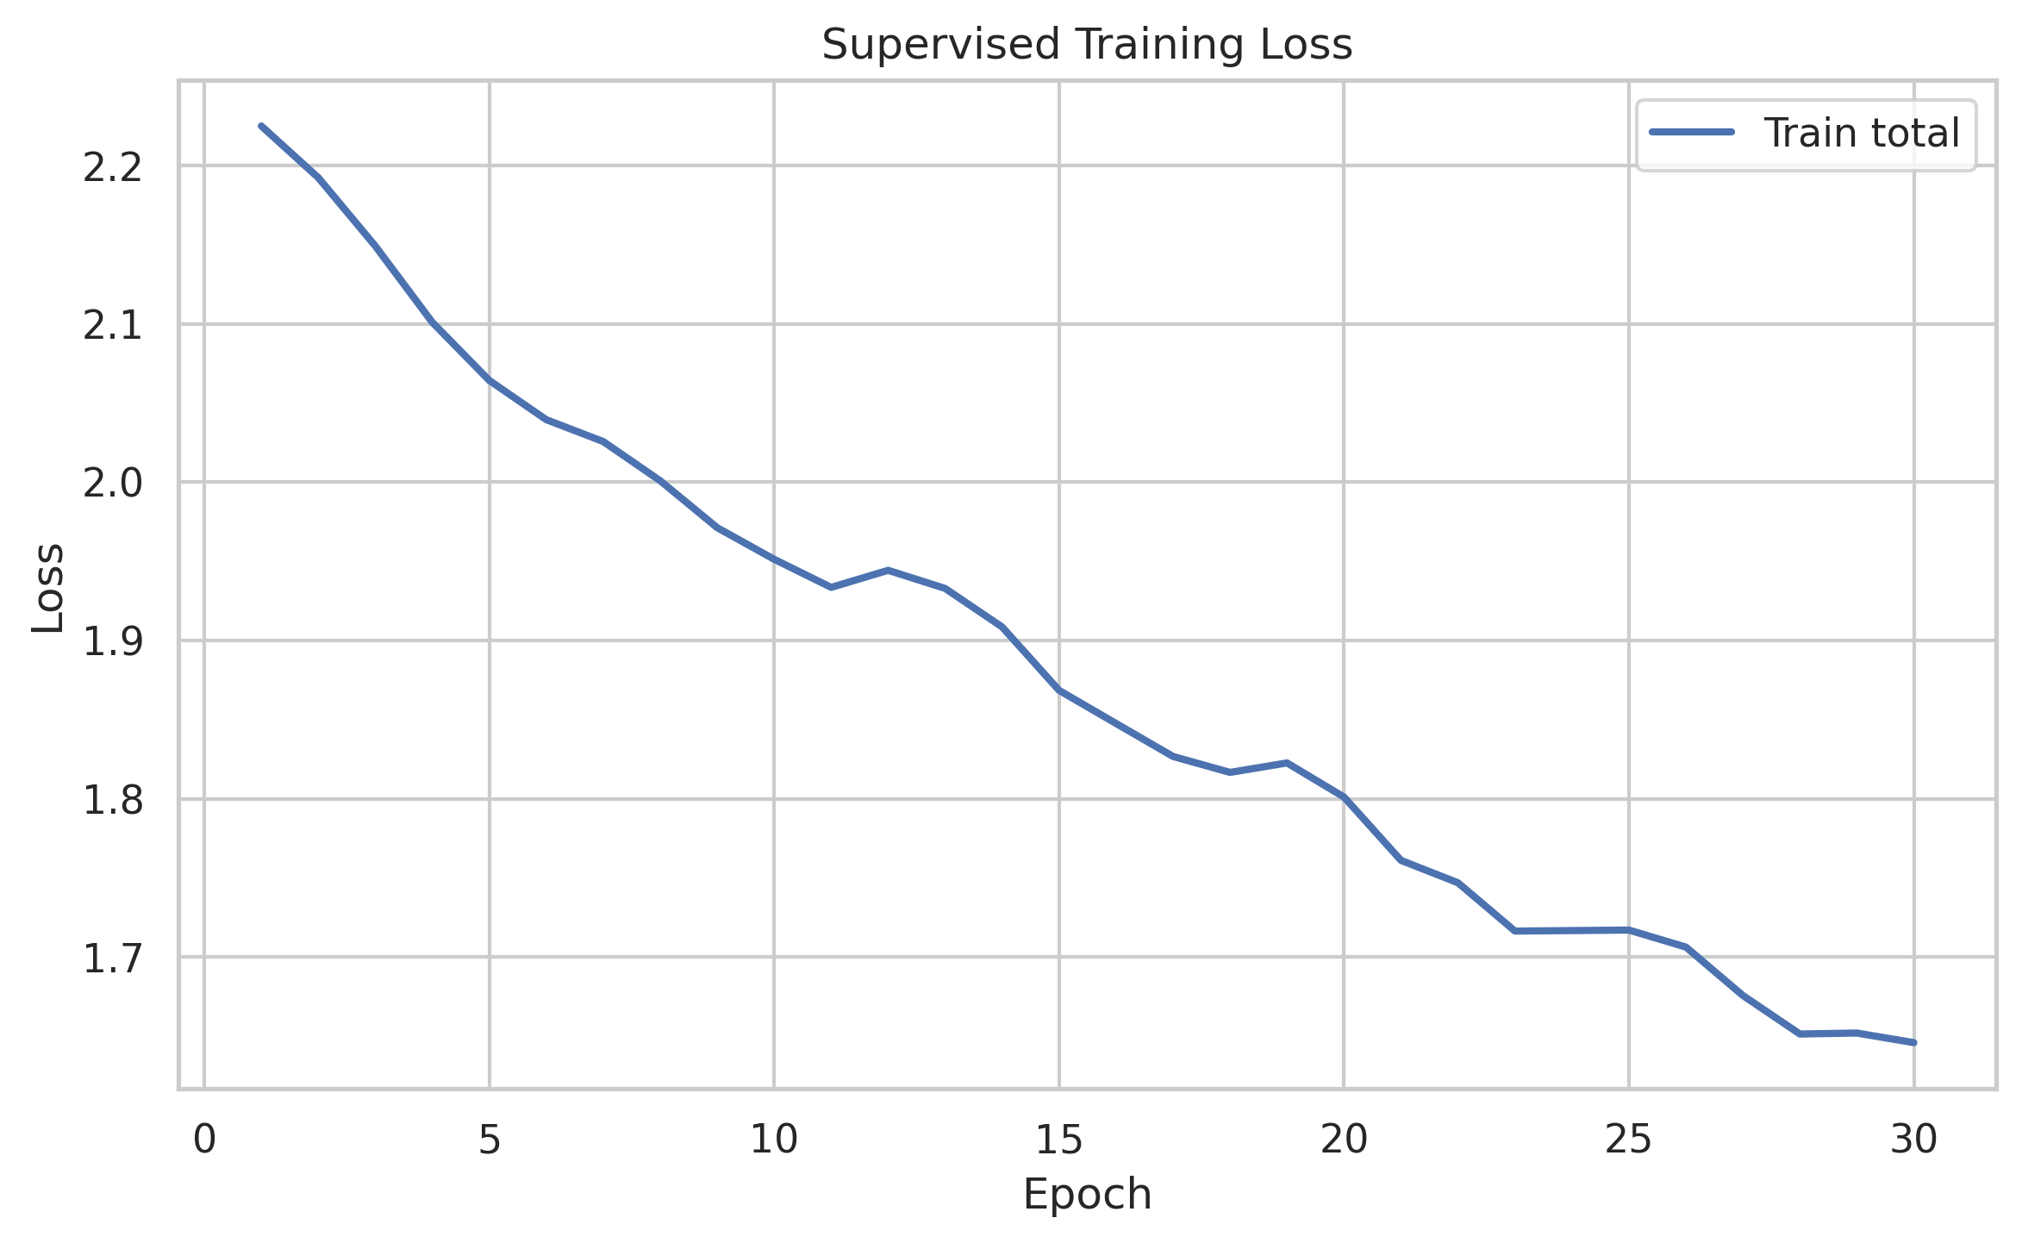
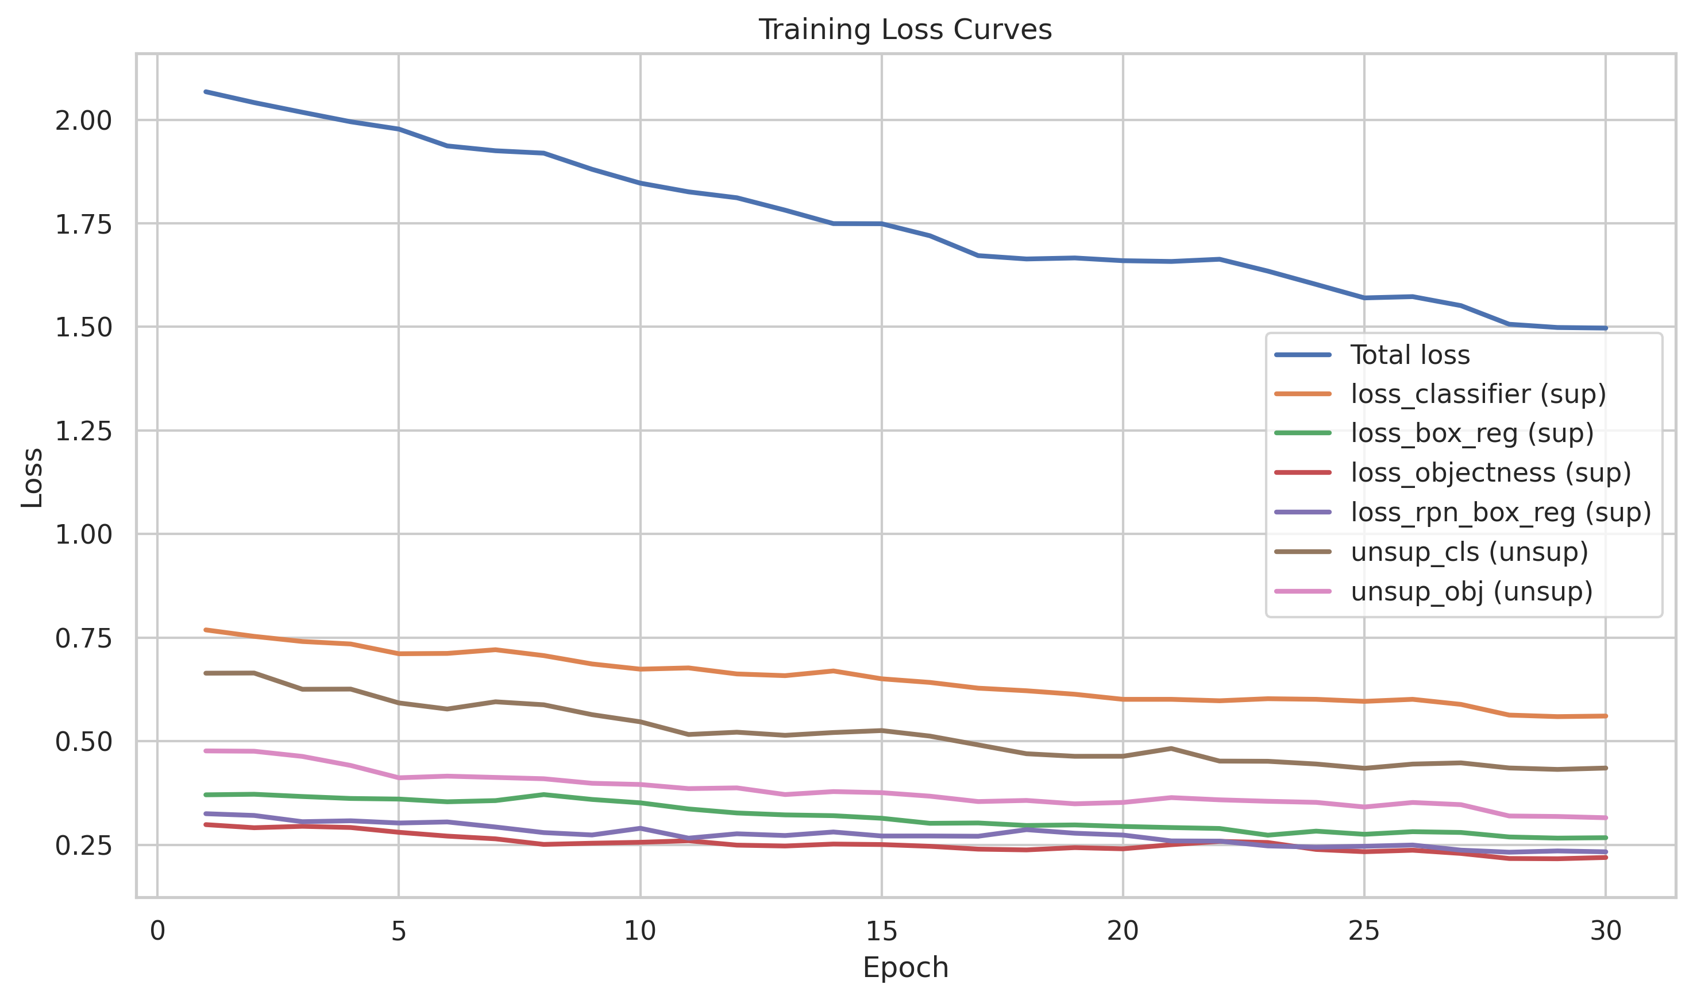
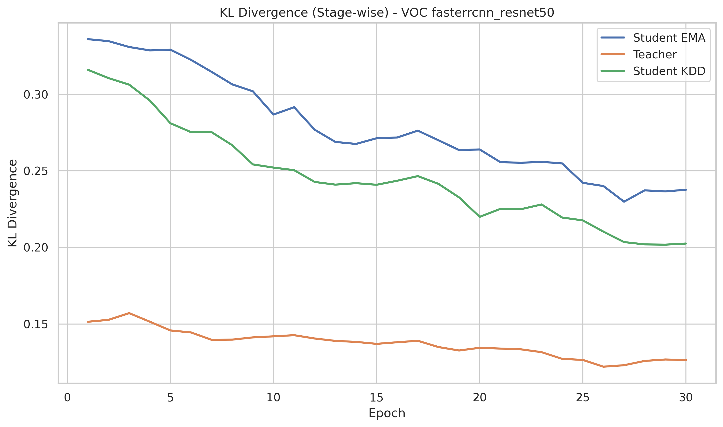
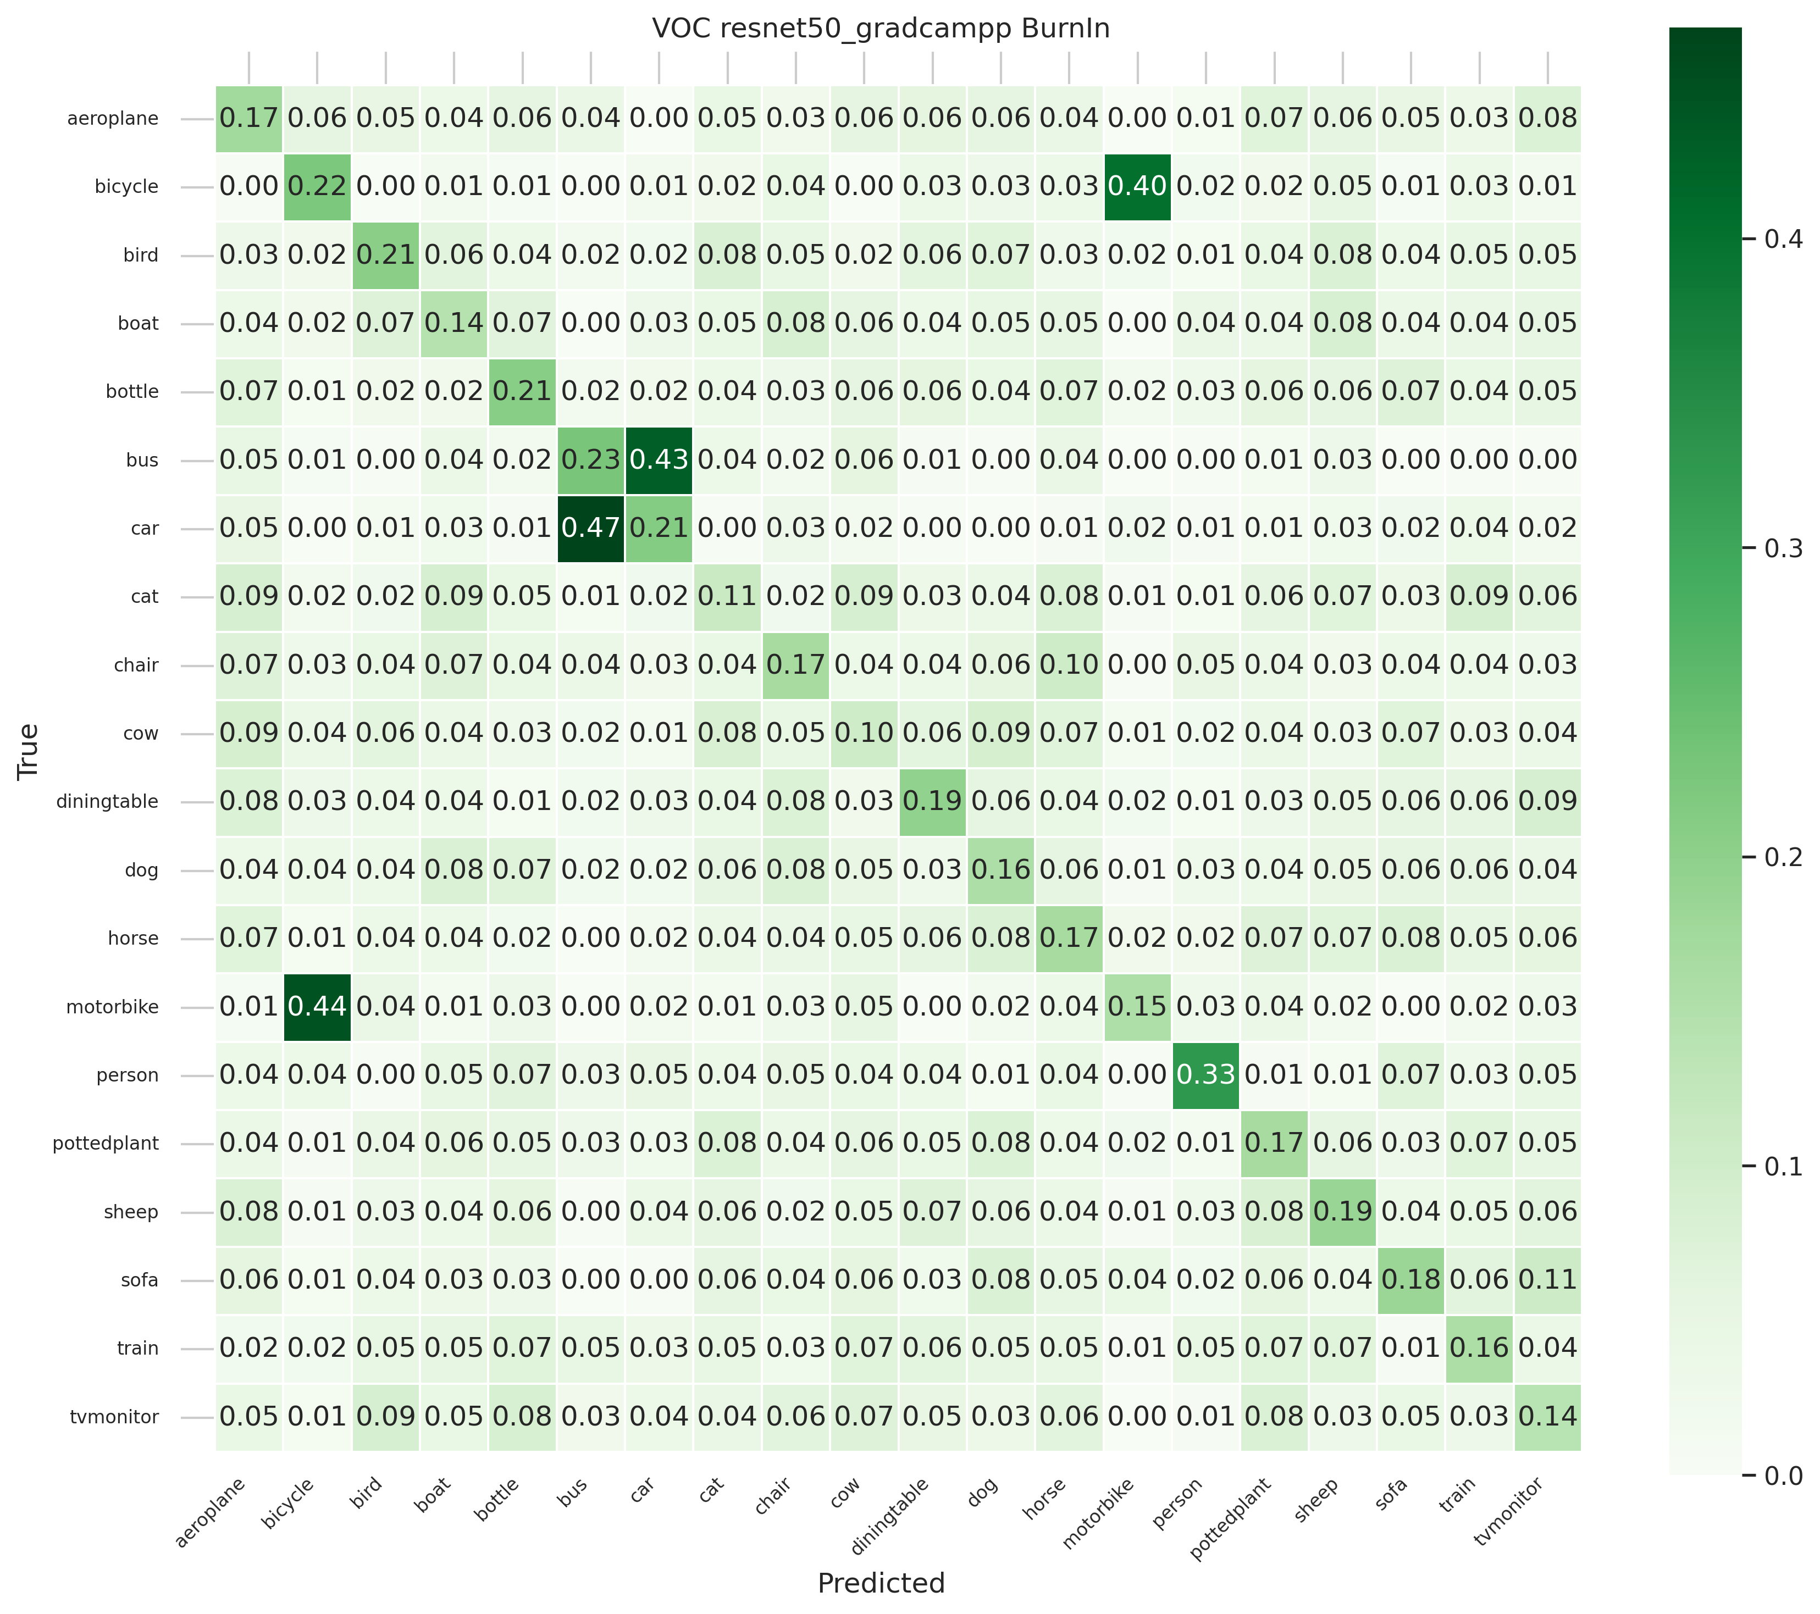
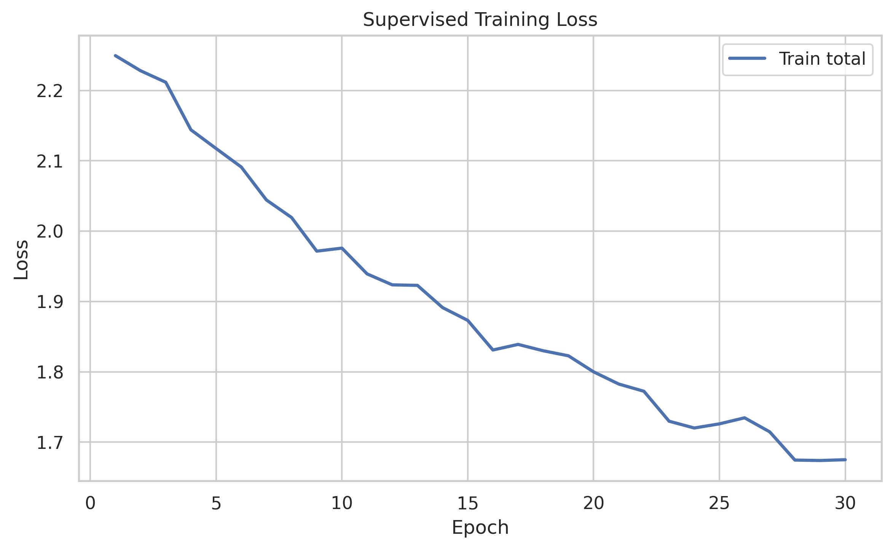
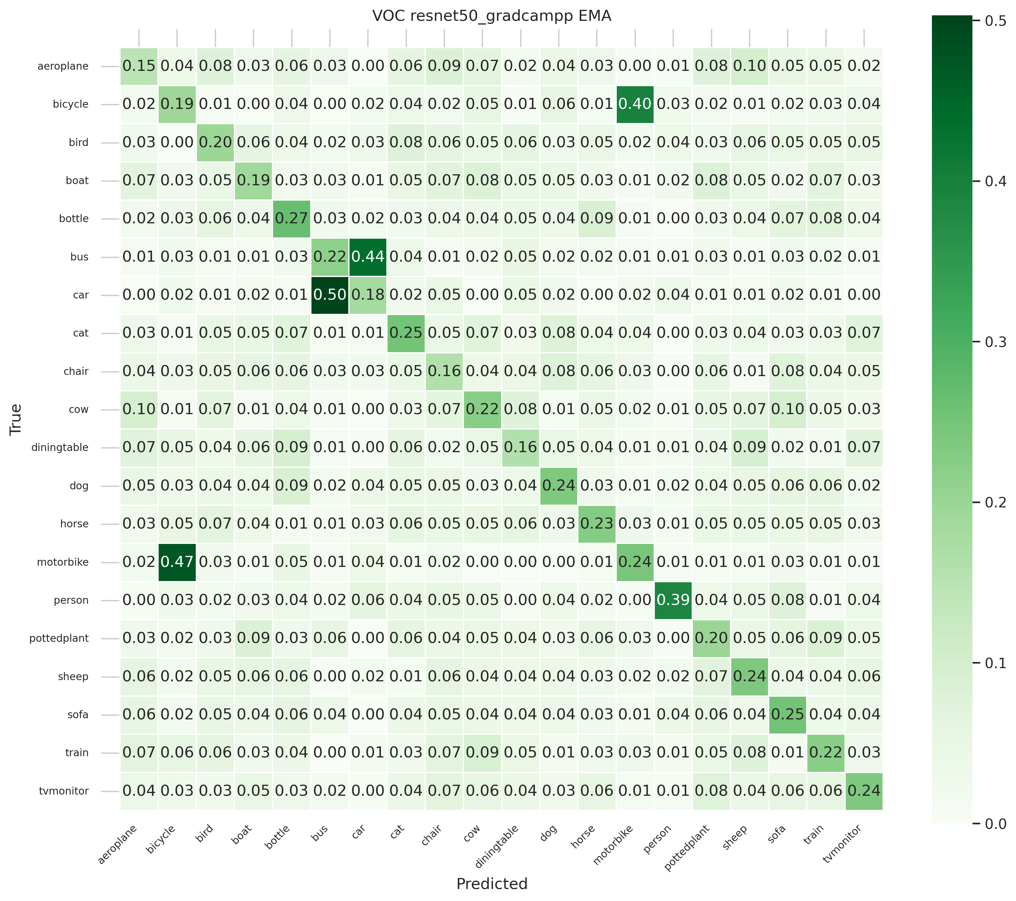
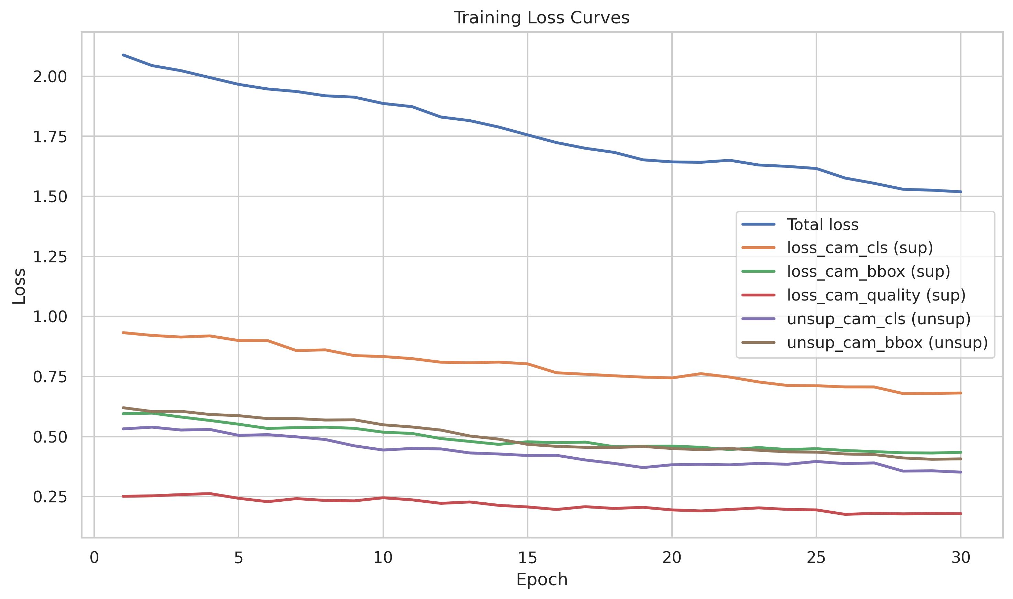
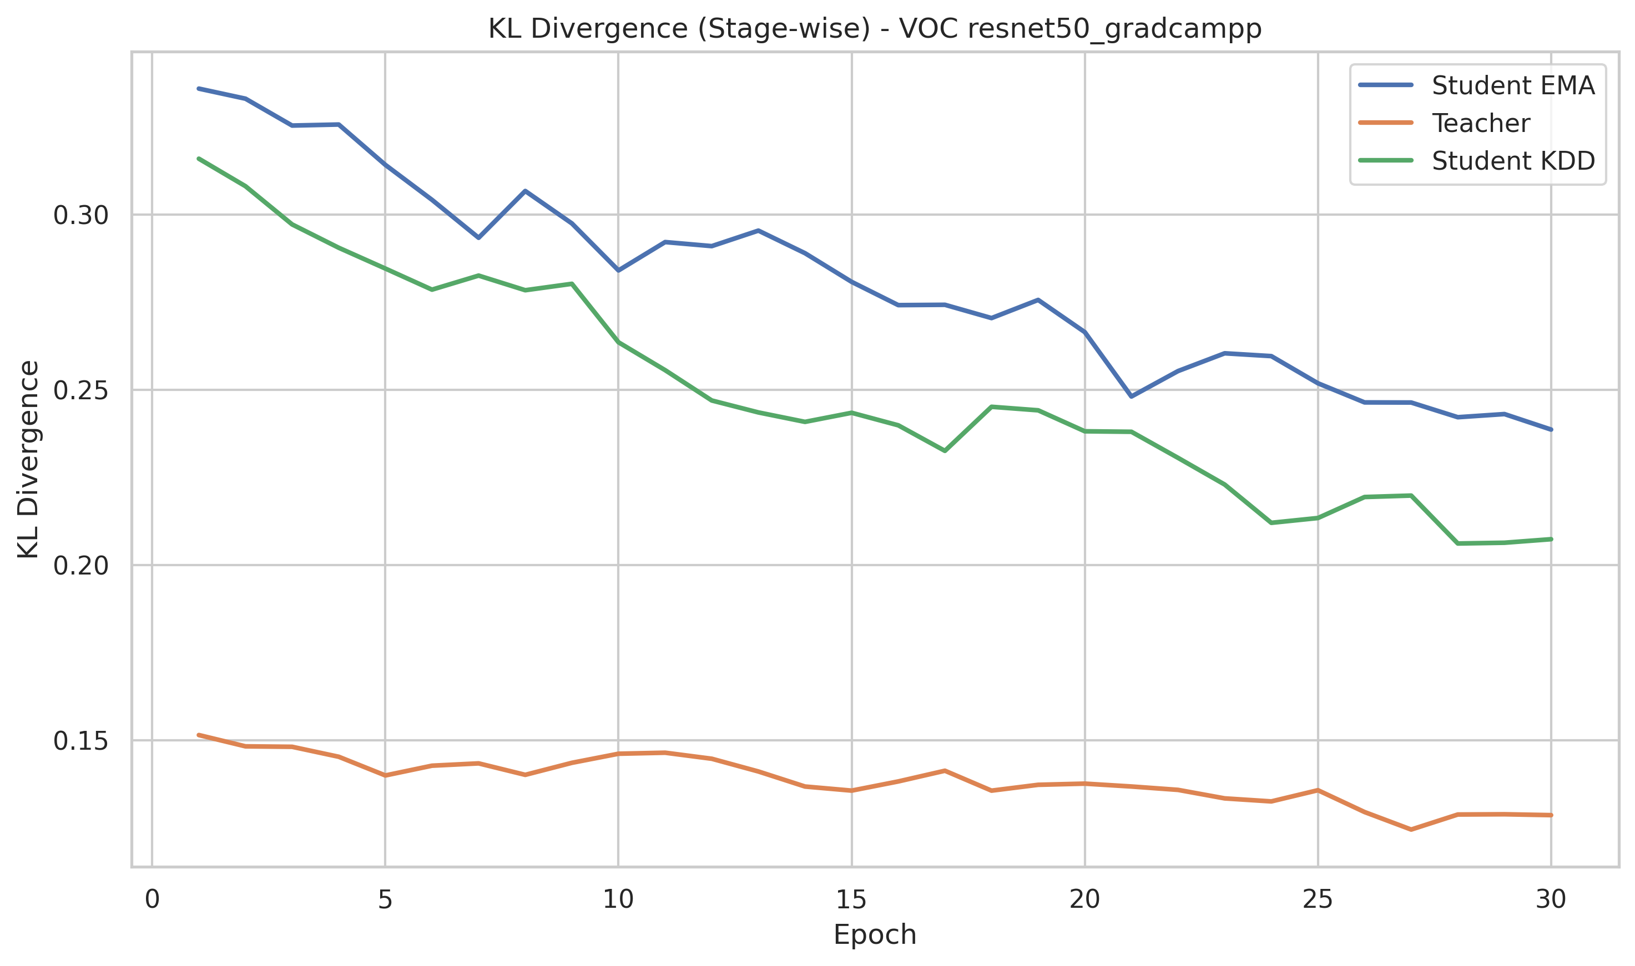
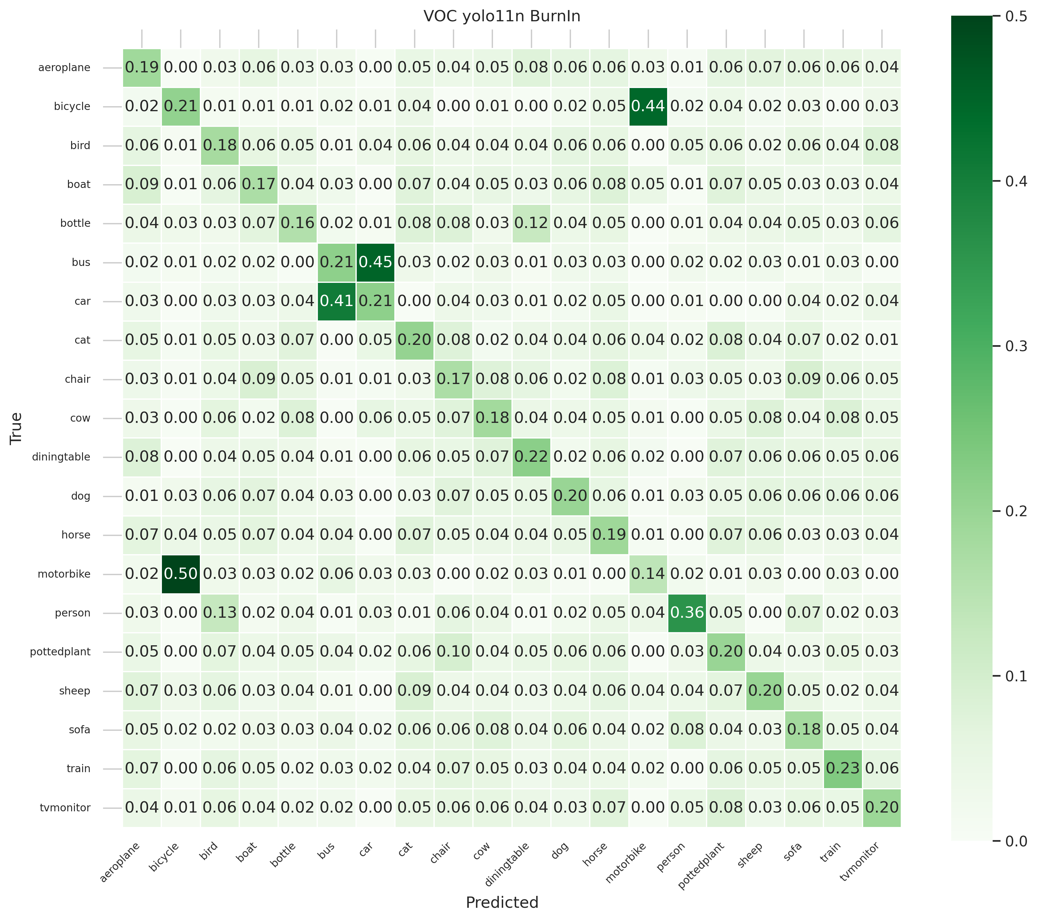
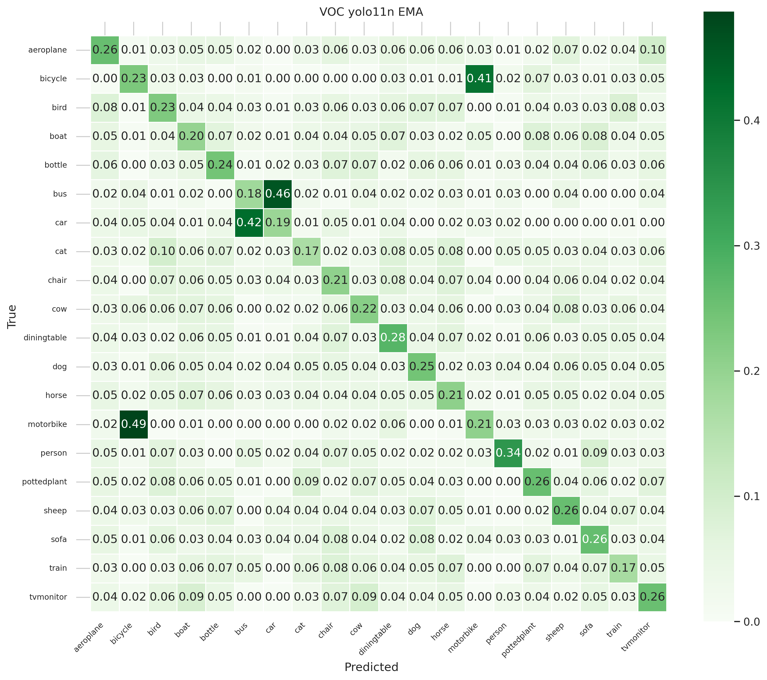
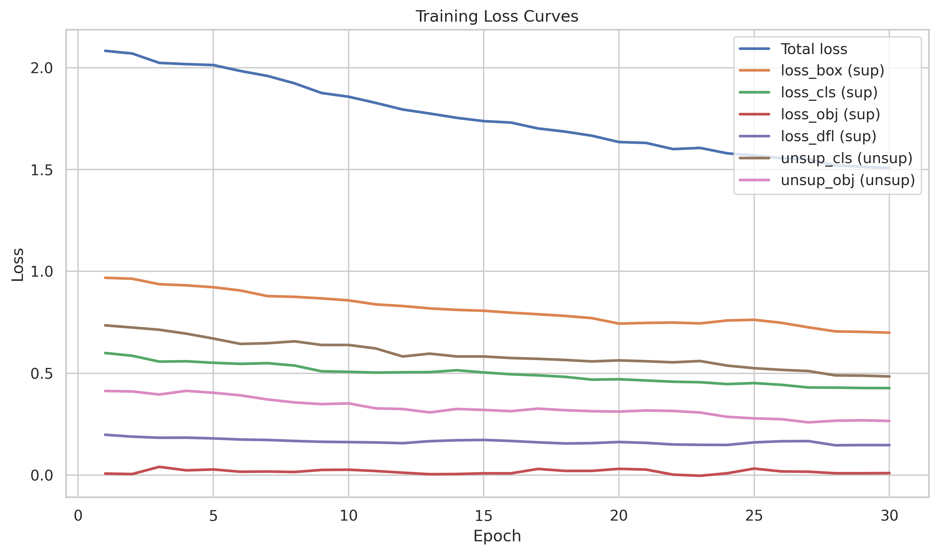
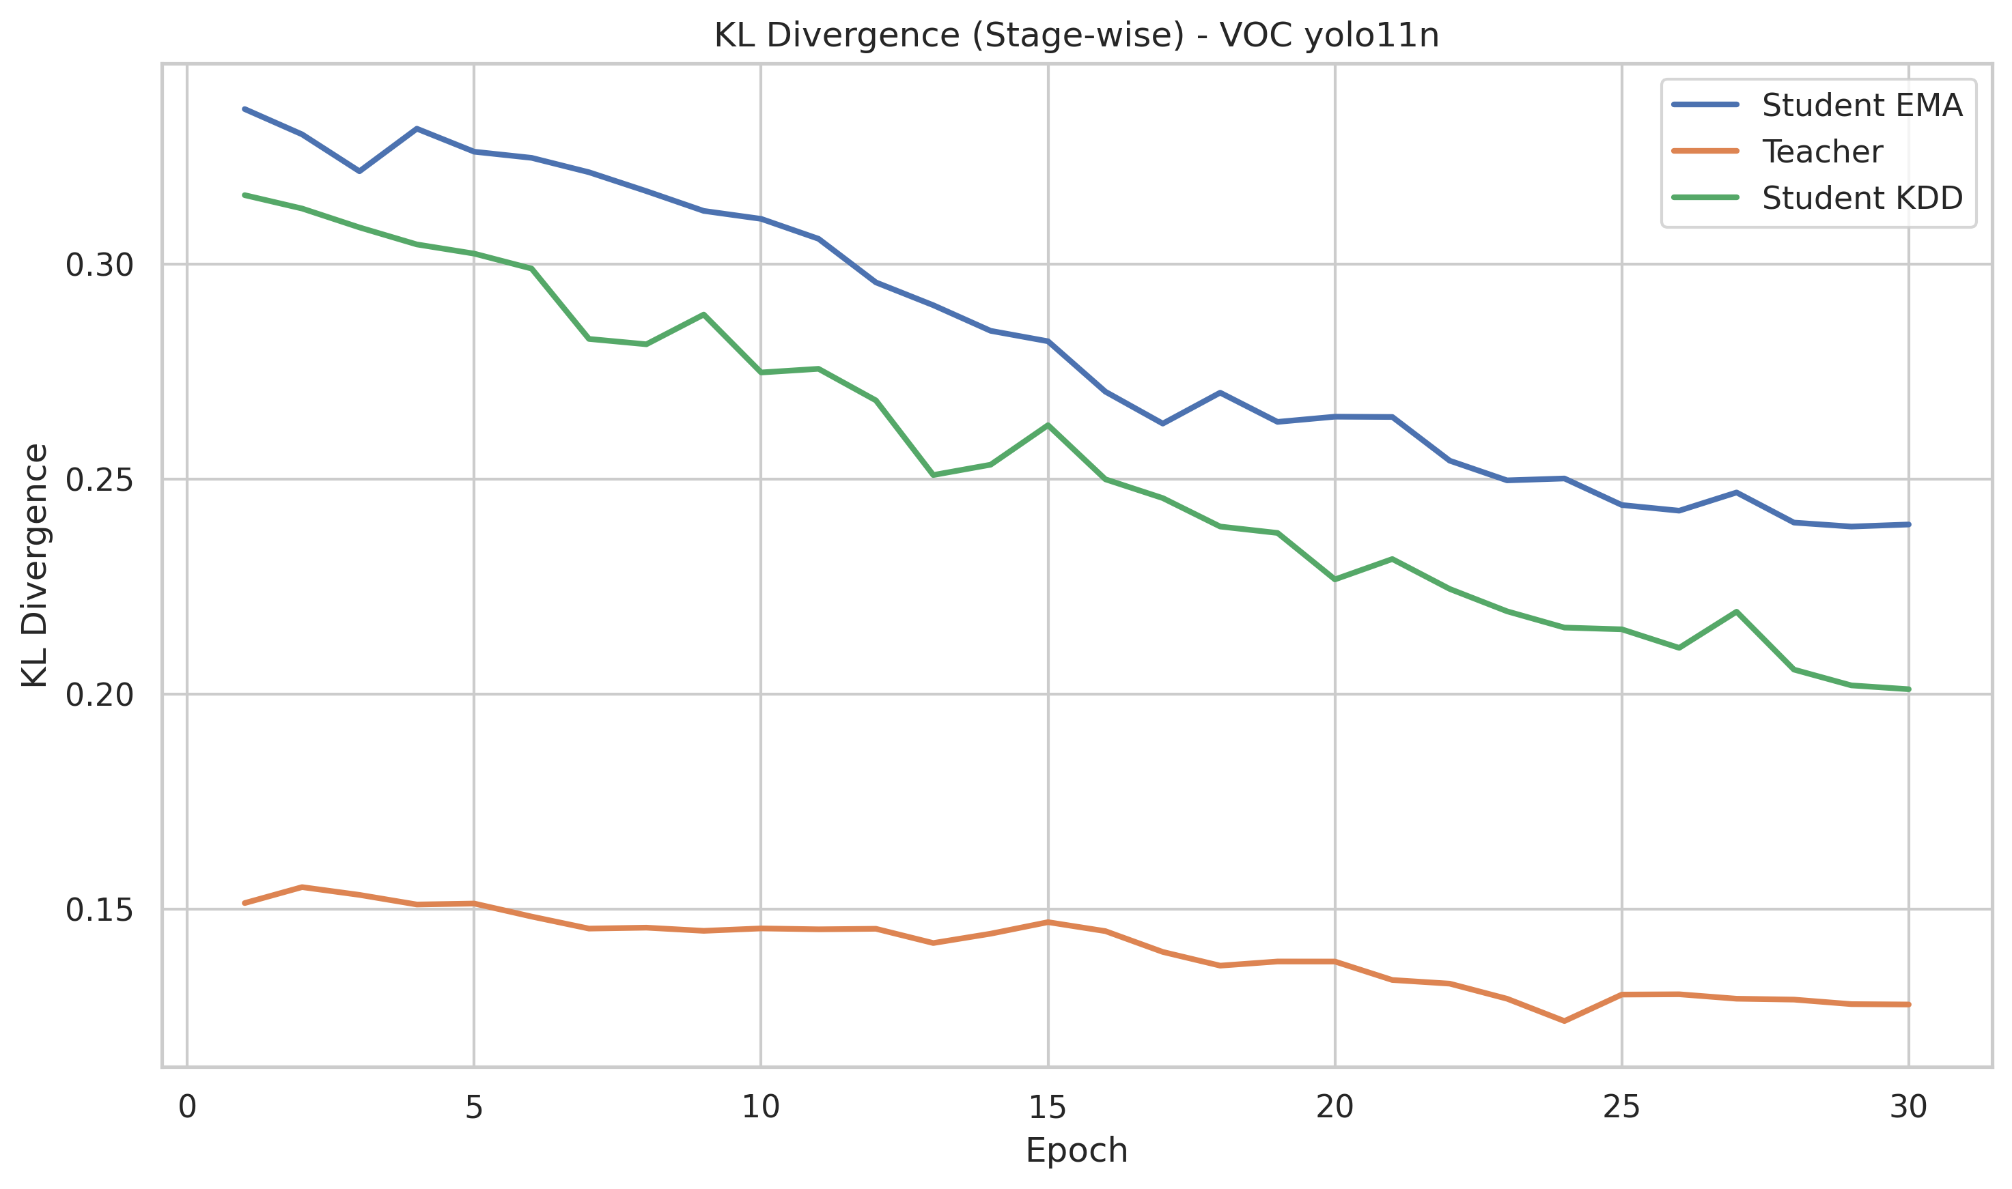
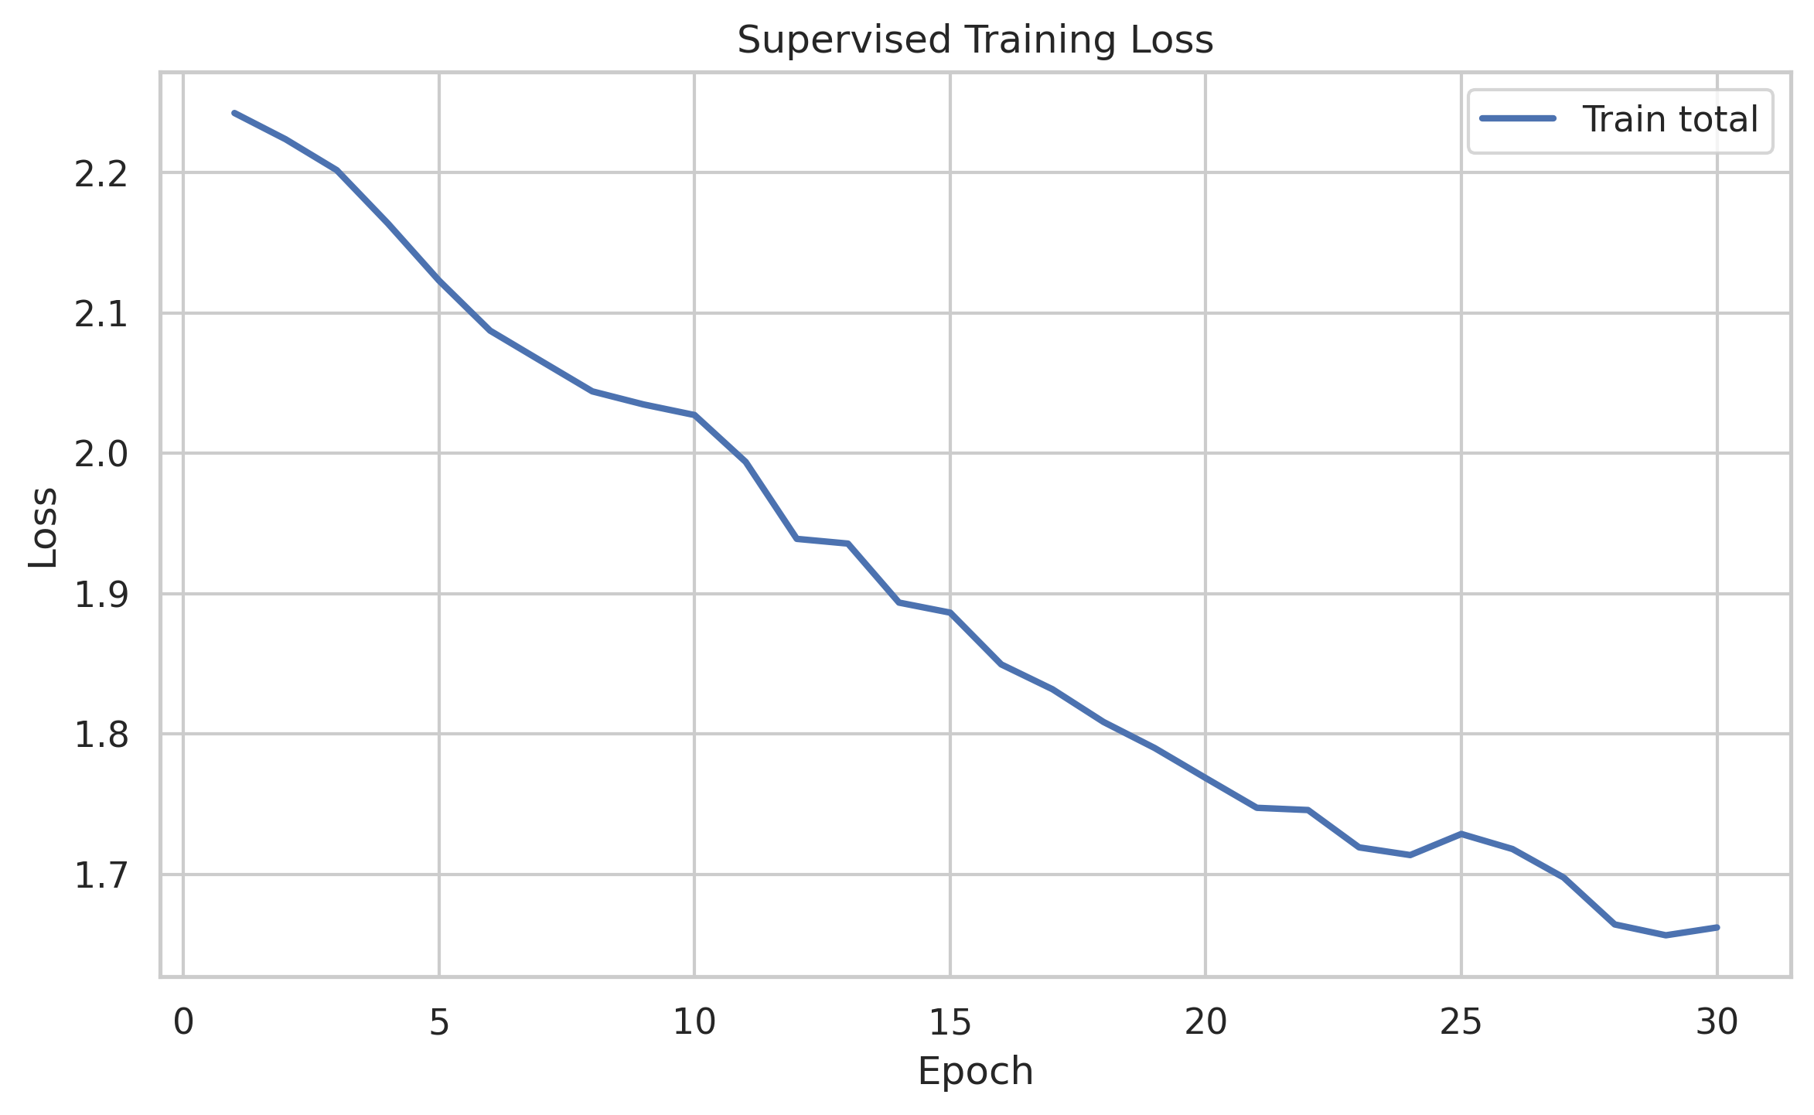
📊Improved evaluation on an already selected dataset
Stable loss convergence across Burn-in, EMA-SSL, and KDD stages
EMA-SSL reduces training noise and improves validation stability
KDD consistently lowers KL divergence, indicating stronger teacher-student alignment
Confusion matrices show reduced class confusion for dominant VOC classes
Overall performance improves progressively from Burn-in to EMA and KDD
2/5

Slide 3
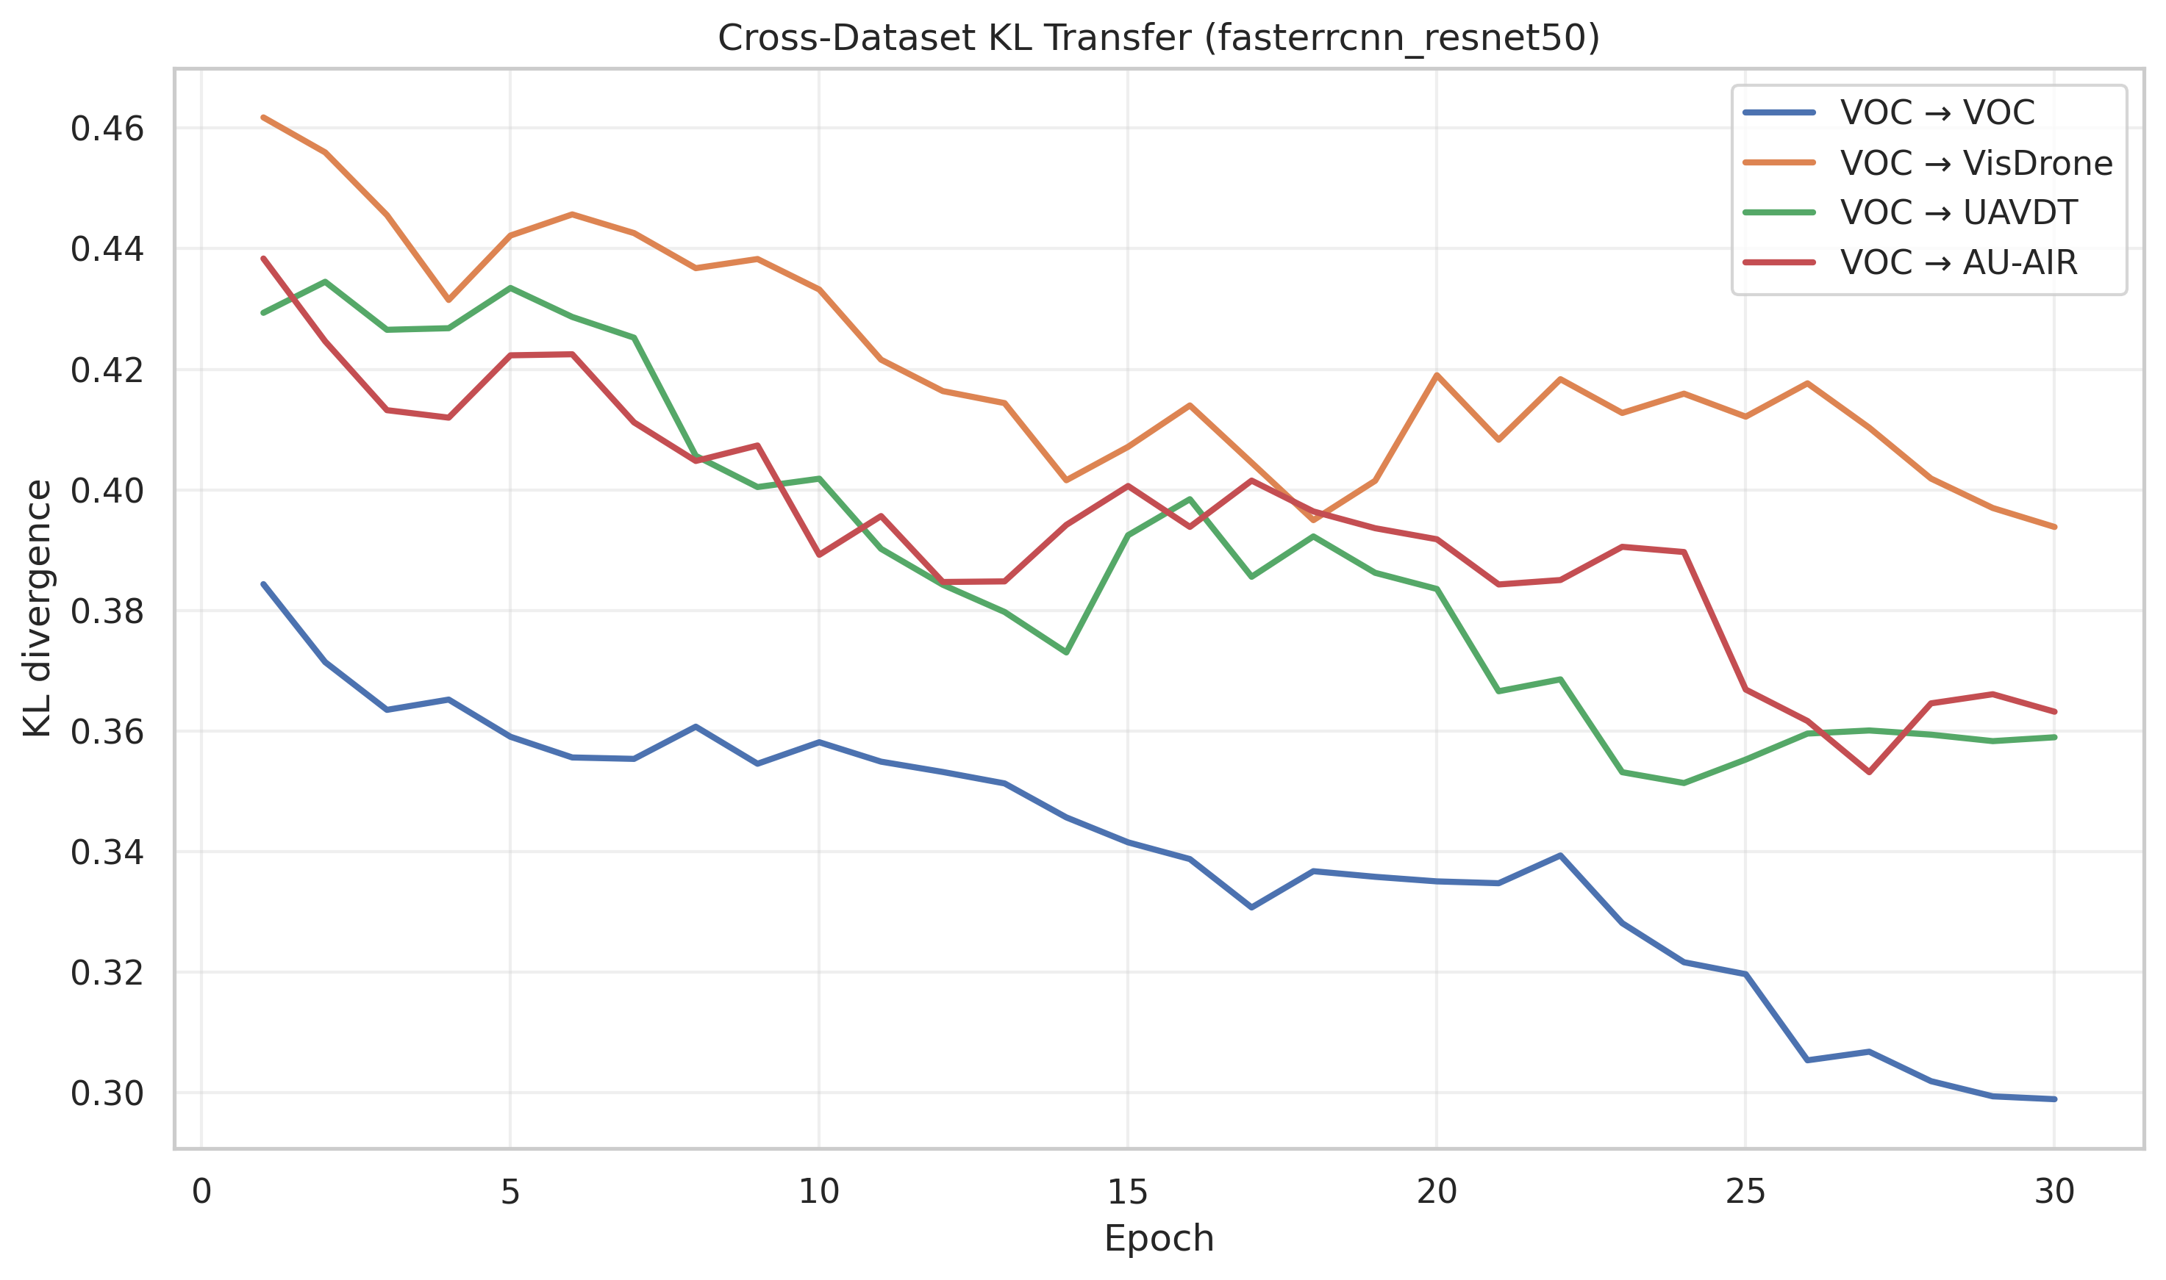
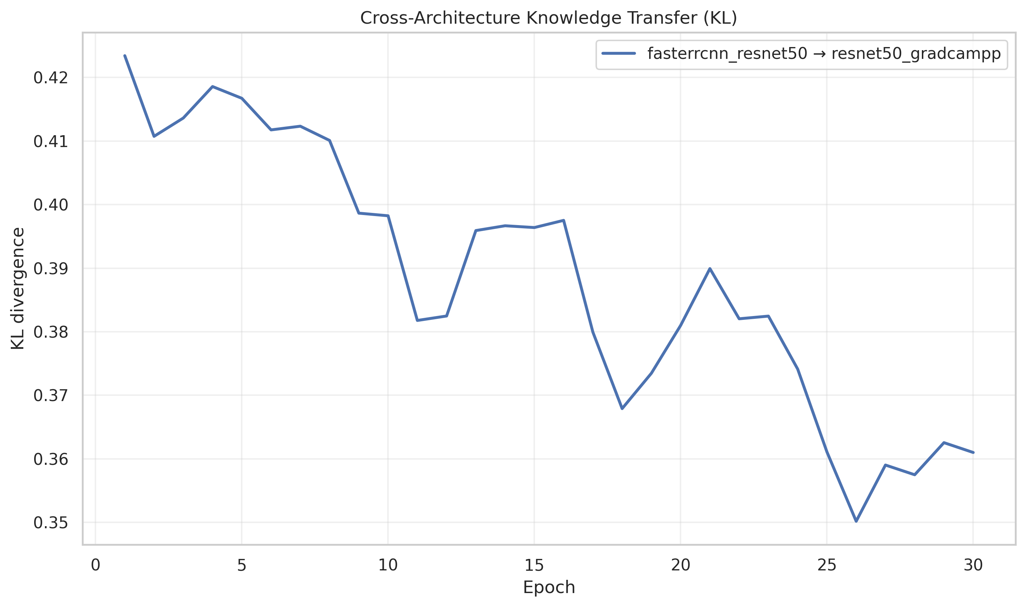
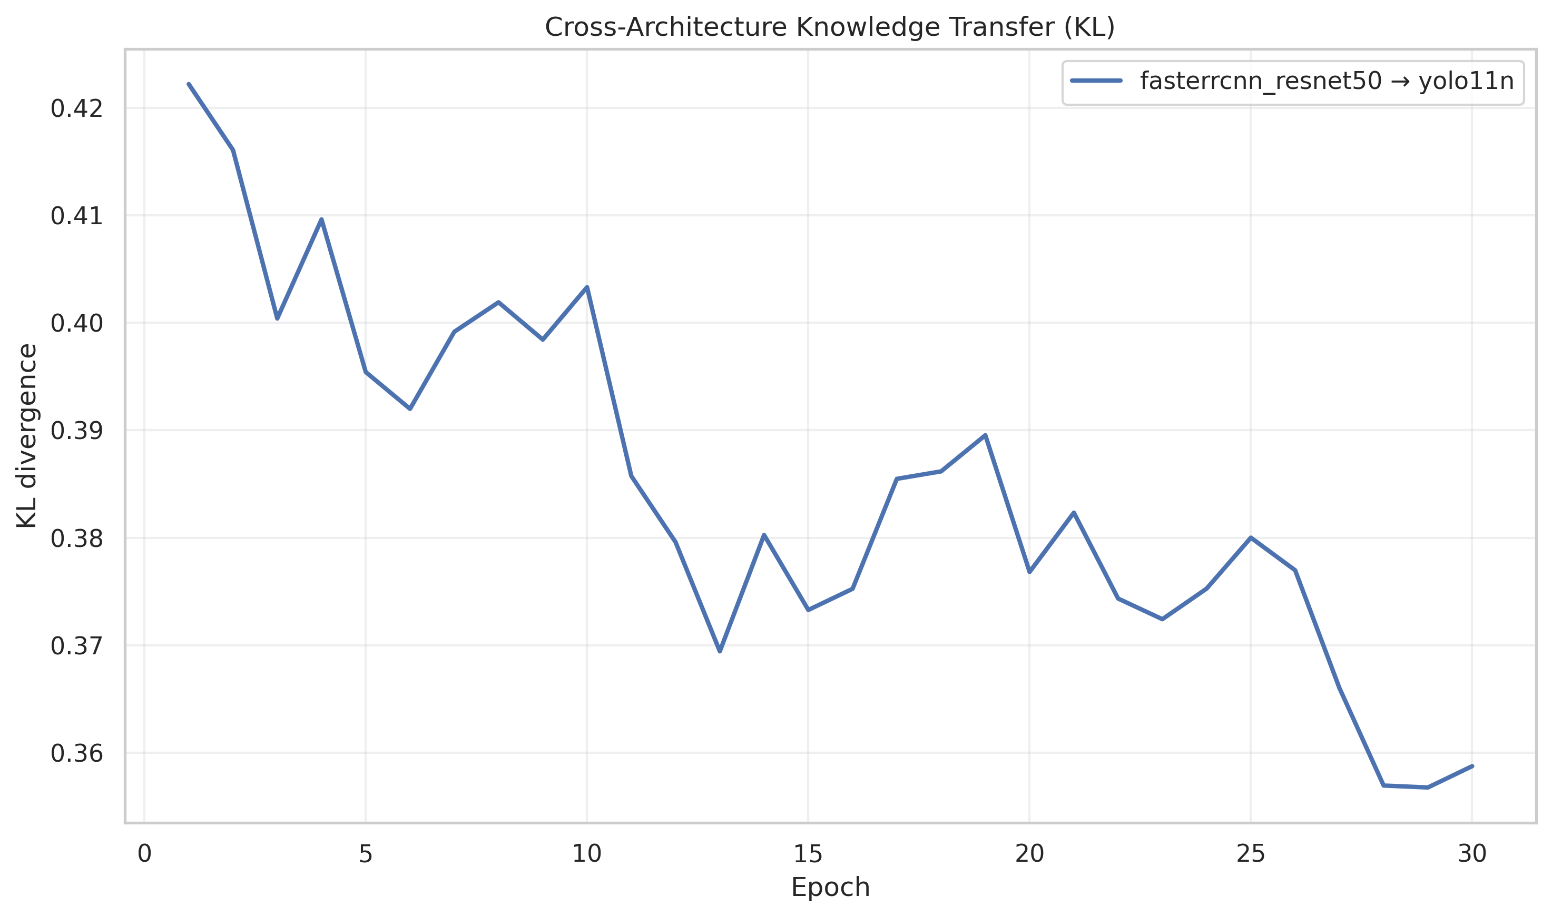
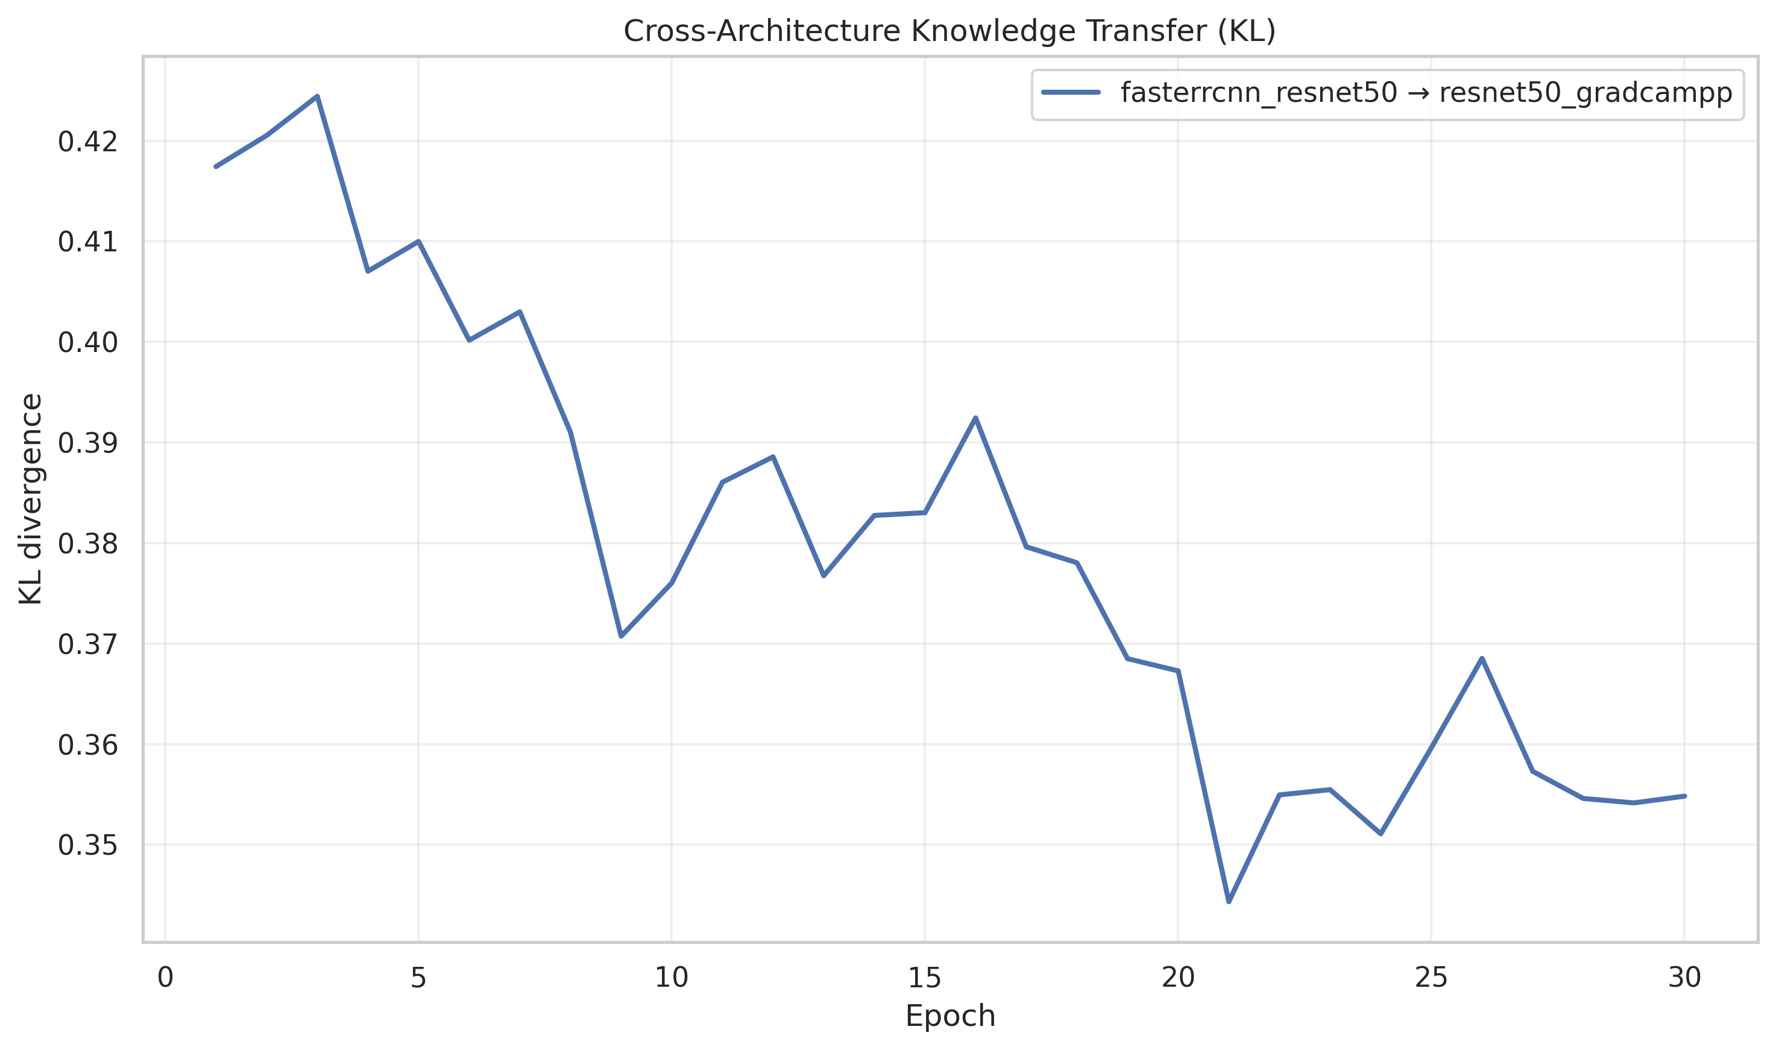
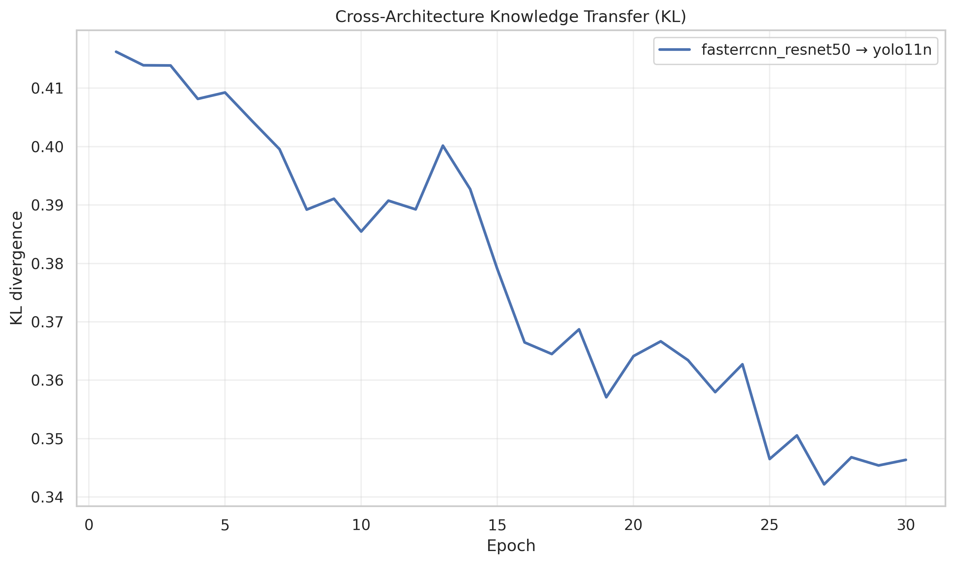
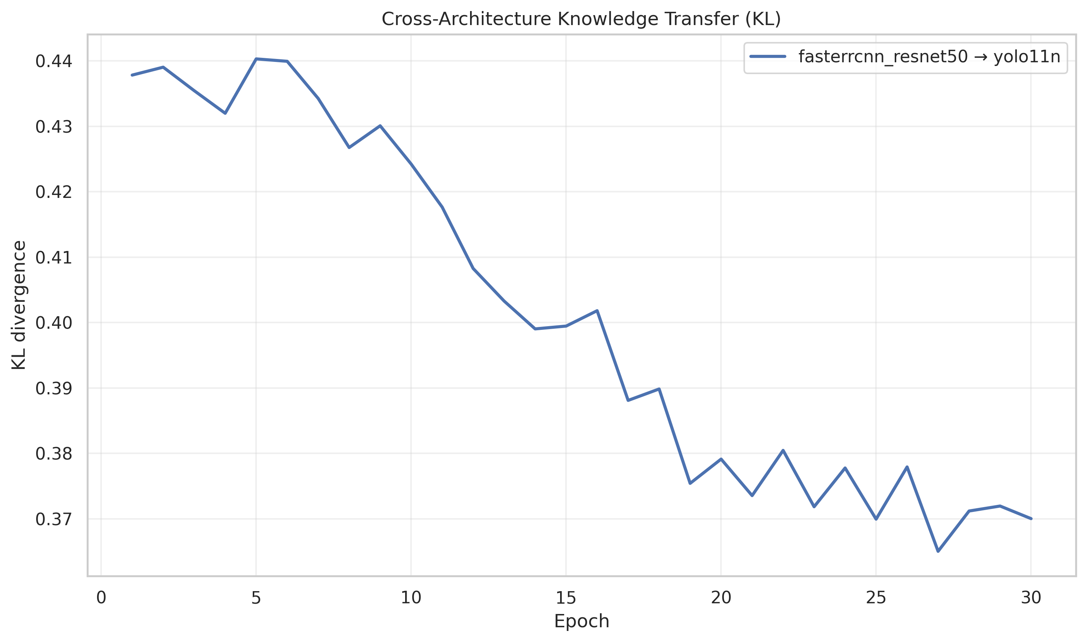
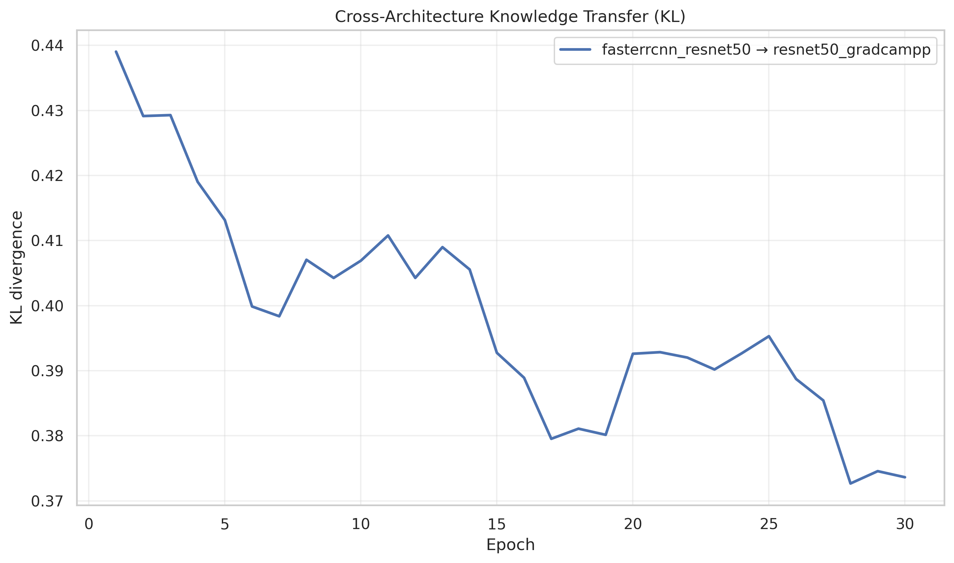
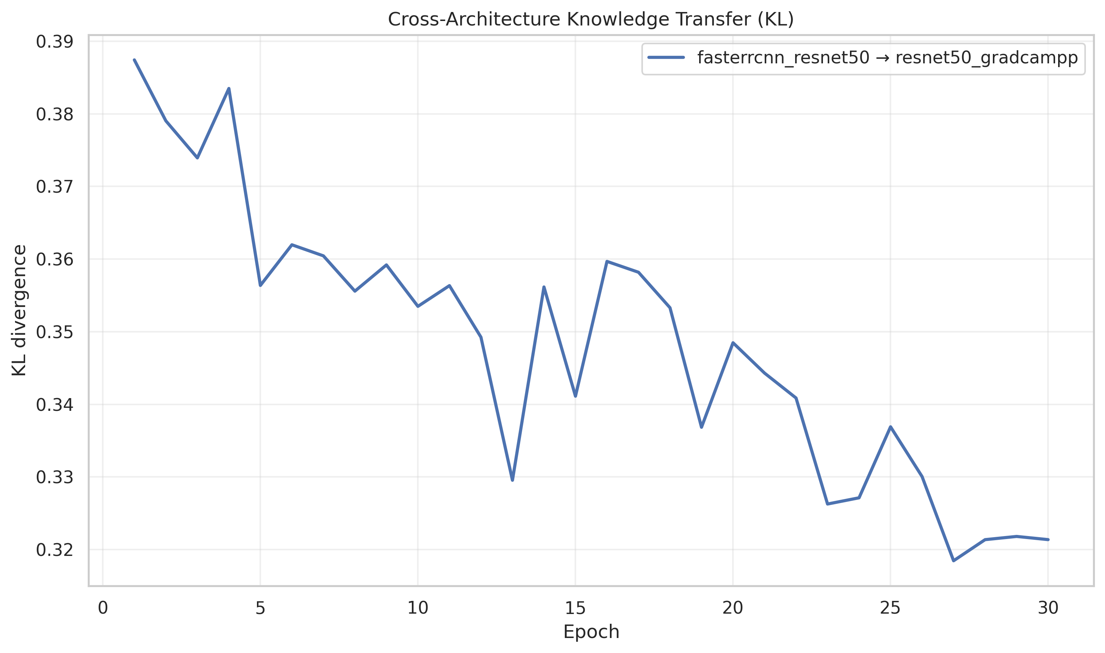
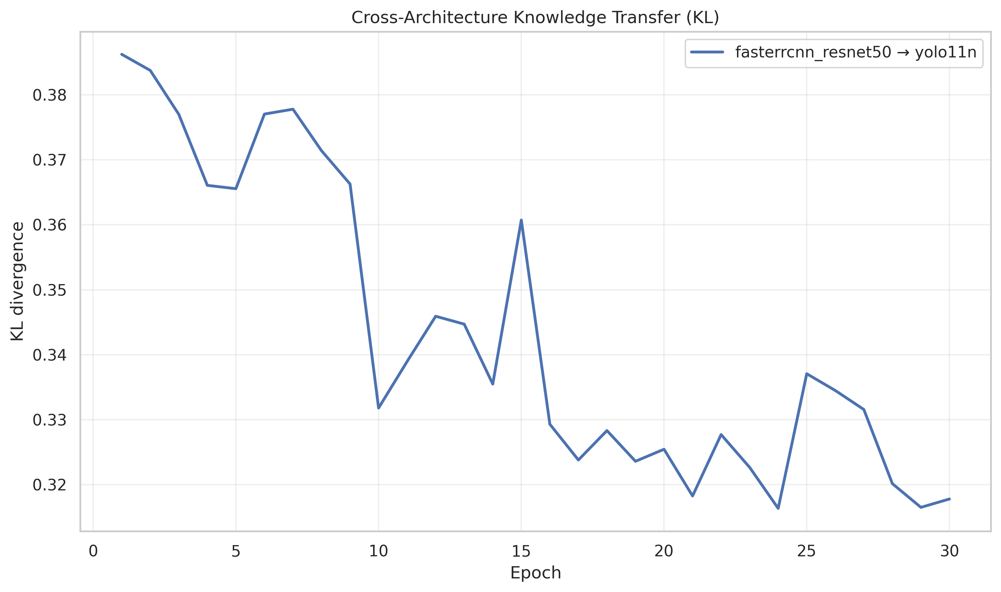
🧪Evaluate on a new dataset (generalize)
Transfer setting
Motivation
Burn-in
EMA-SSL
KDD
Takeaway
- trained on VOC, evaluated on VisDrone / UAVDT / AU-AIR
- assess robustness under domain shift (scale, density, viewpoint)
- provides usable baseline but high confusion for domain-specific classes
- improves precision-recall balance and stabilizes predictions
- lowest KL divergence and strongest teacher–student consistency
- staged training improves cross-dataset transfer despite expected performance drop
3/5

Slide 4
🔍 New step added to the experiment results
What it includes
loss curves per stage (Burn-In, Unbiased-Teacher, KL Models comparations)
evaluation curves per stage
confusion matrices + detection grids
agreement matrices + KL curves (EMA vs KDD)
[Does the student predict the same class as the teacher and where the confusions come from?]
Result
faster iteration and easier comparison between architectures/dataset (one file per run).
Practical win
reduced debugging time;
issues become visually detectable (class imbalance, collapse, unstable agreement).
EMA stabilize training and reduce noise in pseudo-label supervision. KDD transfer teacher knowledge by aligning student output distributions via KL regularization.
4/5

Slide 5
🔁Changes in proposed experiment setup and motivation
Decision timing: weakly supervised approach abandoned before Project Status 1
Reason: intermediate experiments showed poor inference behavior and unclear architectural gains
Issue: proposed weak-supervision architectures were hard to control and evaluate consistently
Action: reverted to a simpler and stable staged learning pipeline
New direction: test student-teacher learning with different model architectures
EMA stage (2): use heterogeneous teacher-student pairs to stabilize learning
KDD stage (NEW 3): evaluate knowledge distillation as a quality refinement step
Benchmarking setup: Faster R-CNN (ResNet-50) kept as the main benchmark
Comparison models: GradCAM++-ResNet50 and YOLOv11 evaluated under the same training pipeline
Goal: ensure fair, controlled comparison within a unified learning pipeline
5/5

